Slide 1
XGame Jungle: Domain Analysis
And Yet It Compiles
Isaac Mauro, Laura South, Duck Keun Yang, Brian Larson, Yan Wang

Slide 2
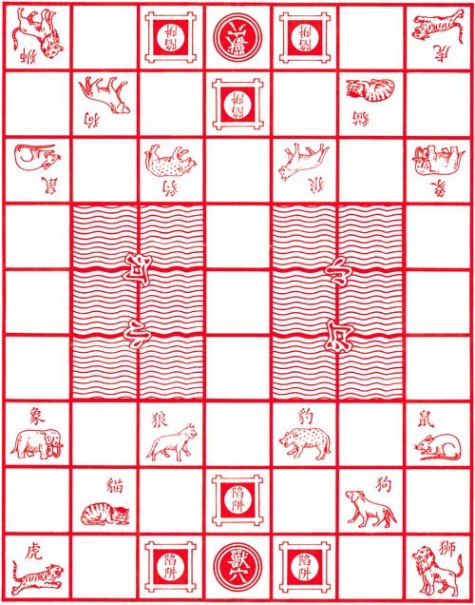







Jungle Recap
Rank | Piece
8 | Elephant
7 | Lion
6 | Tiger
5 | Leopard
4 | Wolf
3 | Dog
2 | Cat
1 | Rat
2 players
16 pieces total
9X7 board
Pieces have power 1-8
Objective is to get into the other players den

Slide 3
Initial Analysis of Potential Conceptual Classes
Possible Conceptual Classes
User
Player
Game
Profile
Game history
Registered users
Online users
Invitation
Authenticator
Game record
Game board
Game piece
Game tile
physical or tangible objects | Game board, game piece, game tile, invitation?
Specs, descriptions, or designs of things | Game record, profile?
Places | Game tile? Profile?
Roles of people | User, player
Containers | Registered users, online users, game history, profile
Things in containers | Game record, user
Collaborating systems | Authenticator
Abstract noun concepts | Invitation
Events

Slide 4
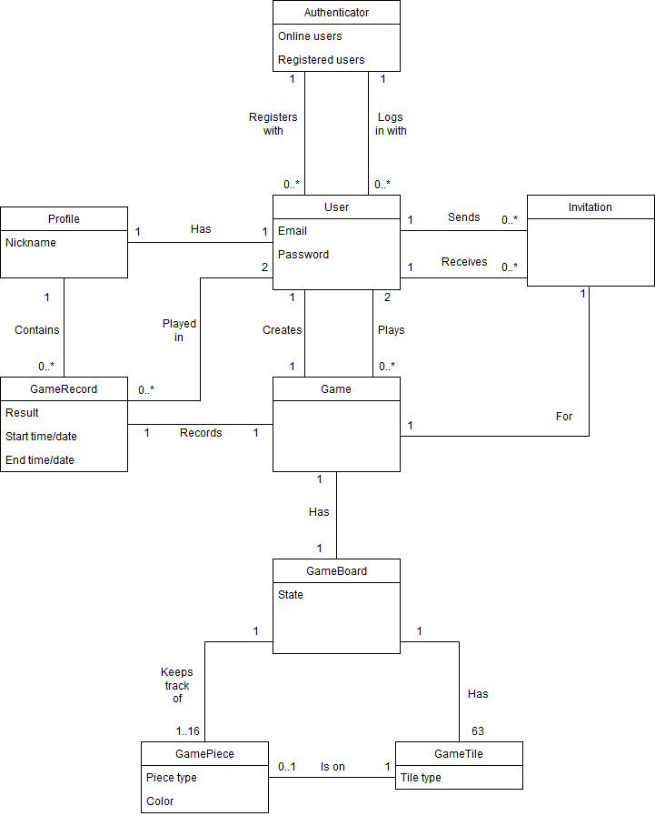
Creating the Model
As we iterated on the model, we narrowed the possible conceptual classes to the following:
Authenticator
User
Profile
Invitation
Game
GameRecord
GameBoard
GamePiece
GameTile

Slide 5
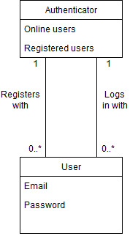
Authenticating Users
The user registers and logs in to the system using the authenticator
The user has access to one authenticator at a time, and authenticator can handle multiple users simultaneously
Authenticator maintains lists of registered users and online users
User contains email address and password

Slide 6
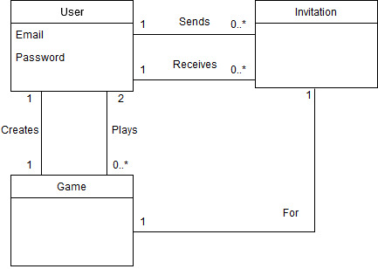
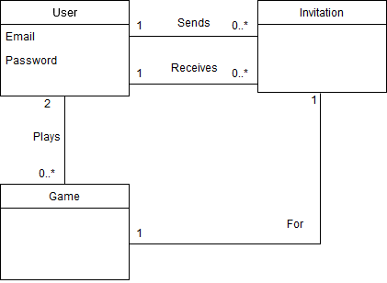
Sending Invitations and Joining Games
The user can send the invitation to multiple other users
The user can receive the invitation from multiple other users
Each invitation is associated with a game
Once the invitation has been accepted, the game starts immediately

Slide 7
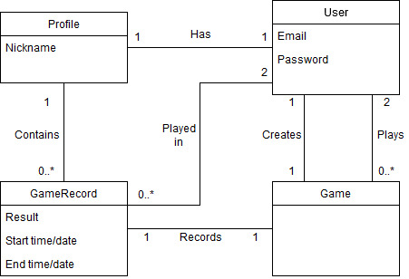
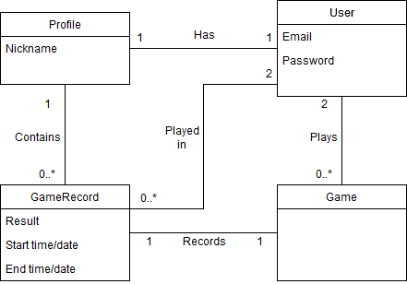
User Profiles
Each user has exactly one profile
The profile has a nickname to be shown to the public
A profile is associated with 0 to many game records
One game record is made from a single game
Each record is associated with exactly 2 users who played in the game
The game record contains the result, and start/end date and time.

Slide 8
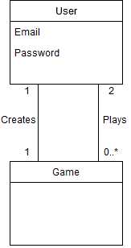
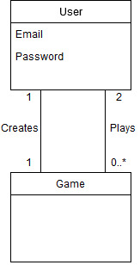
Creating and Playing games
A user can creates one new game session at a time
Once the game session has been created, the user can invite other players.
Once two players are in the game, the game starts, and the user can create another game session
A user can plays multiple games at a time, and a game requires exactly two players

Slide 9
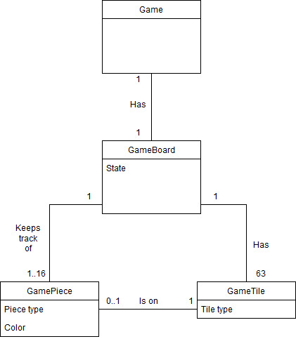
The Jungle Game
A game has exactly one game board
A game board tracks the state of the board
A game board has 63 game tiles, and 1 to 16 game pieces
A game tile can be differentiated based on the tile type attribute
0 to 1 game piece can be placed on a game tile
A game piece contains piece type and color attributes

Slide 10
Changes to Use Cases
Database(Secondary Actor) removed
Log out use case added
Playing multiple games is now explicitly addressed in the use cases
Alternative flow for system failure added
Modified some of the preconditions to be more specific
Extension points are explicitly stated in the description
Open Discussion:
What information should we keep in the system after a user unregisters?

